Slide 1
AUTOMATION
SCENARIOS
ARCHIVING LOGS

Slide 2
What Is the Archived Redo Log ?
Oracle Database lets you save filled groups of redo log files to one or more offline destinations, known collectively as the archived redo log, or more simply the archive log. The process of turning redo log files into archived redo log files is called archiving. This process is only possible if the database is running in ARCHIVELOG mode. You can choose automatic or manual archiving.

Slide 3
How do I Archive all the matching logs and move the archived files to the backup directory ?

Slide 4
P s e u d o C o d e
Read Input : Directory under which all log files are located. Example: /var/log
Read Input: Extension of the log files. Example: .log
Read Input: Location of the backup directory
Run: Use archiving executables such as 7z or tar to create archives of the logs matching the given input.
Move the created archive files to the backup directory.
Delete the old log files.

Slide 5
The following scenario explains how to archive the logs-

Slide 6
First of all, we need to know the location of the log files as well as their extension in order to archive the logs and to backup them. For this, we’ll take the location as input from the user.
Next, get the location of the backup directory from the user in order to safeguard them to a backup directory.

Slide 7
Space is the one of the most important requirements while working on a system. Most of the Linux Operating System have some existing compression tools and algorithms such as tar, 7zip, unzip, WinRAR which will help us turn our big log files to small archives that will consume much lesser space.
Then transfer the created archives to our backup location and also delete the unnecessary log files.

Slide 8
To get back the log files, we can simply extract them from archive files that we have.

Slide 9
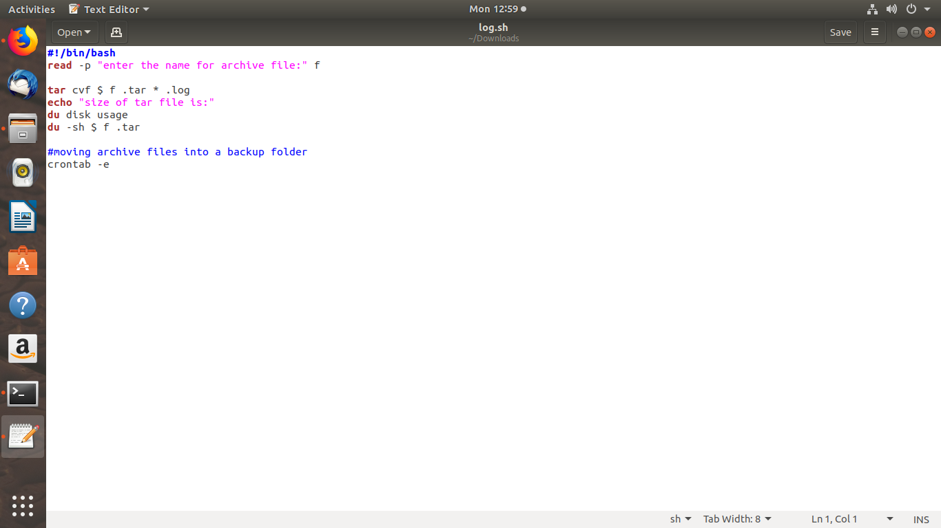
Script to reduce the file size

Slide 10
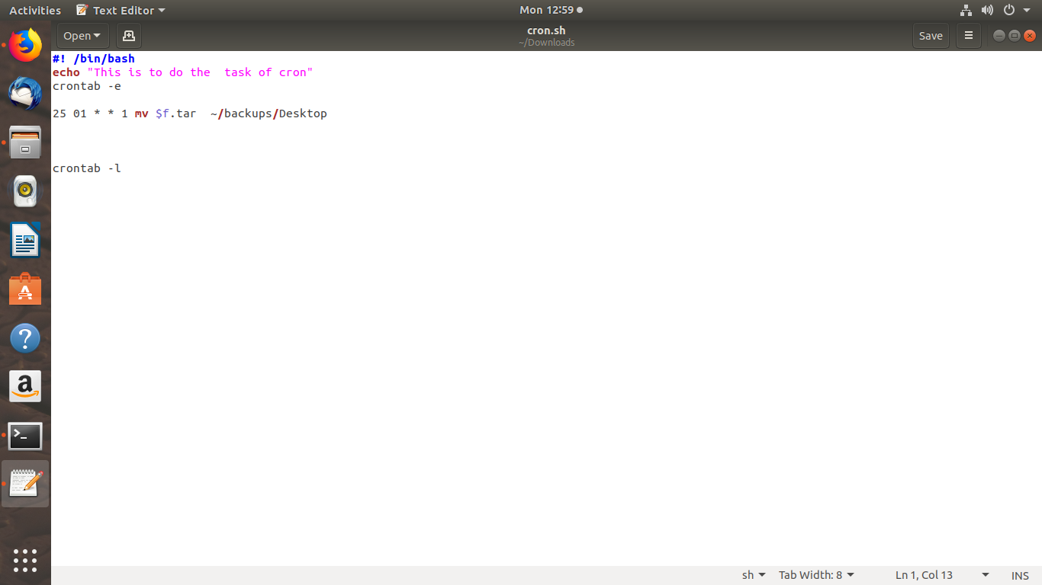
Script to move files in backup folder using cron

Slide 11
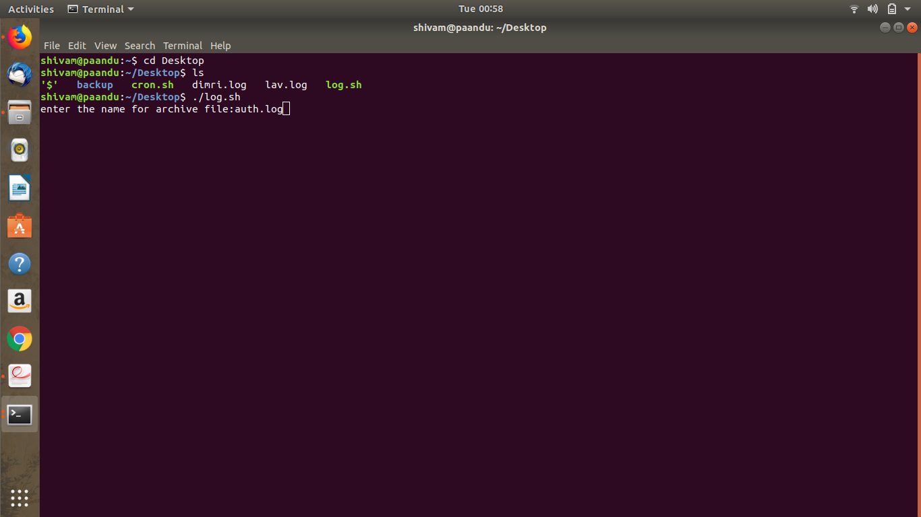

Slide 12
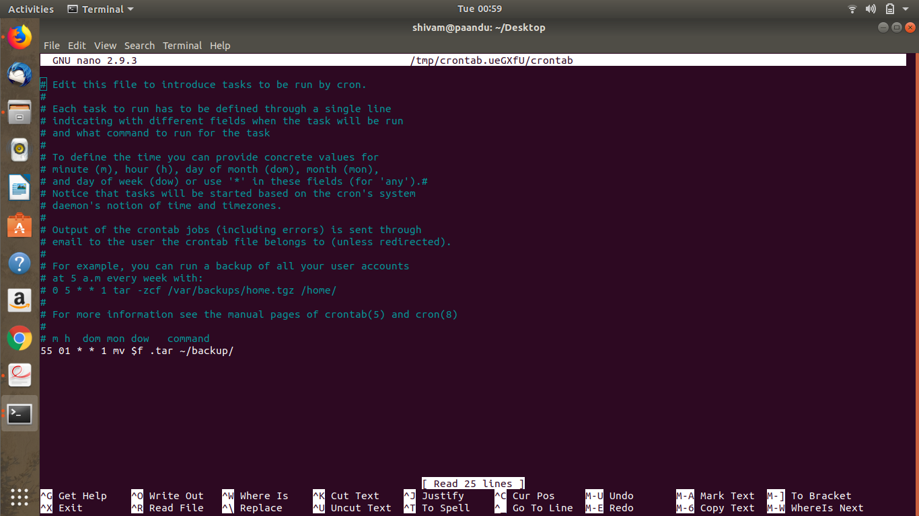
cron page to set backup time

Slide 13
